Slide 1

A Year With Github Copilot
Daniel Morales Fitó

Slide 2

A Year With Github Copilot
Daniel Morales Fitó
Devops Architect
Itequia
Notes:
Developer, Tester, Functional Analyst, Systems Expert, App Expert, Team Lead, Application Manager, Consultant, Project Manager, Product Owner, Support Manager, Devops Expert & Cloud Architect.
Jack of all trades, Master of none, but better than a master of one.
Currently in Itequia.
Want to explain my Case Study of Github Copilot I’ve been leading.
I’ts been actualy almost 2 years, but I think this represents

Slide 3

THANK YOU SPONSORS

Slide 4

(In case you didn’t know….)
Github :
A proprietary developer platform that allows developers to create, store, manage, and share their code
Owned by Microsoft since 2018
Used mostly to host open source code
One of the largest source code hosts in the world
Microsoft Copilots:
Family of generative AIs offered by Microsoft under different licenses and options
Github Copilot:
Generative AI specialised in code completion and automatic programming offered by Microsoft and Github

Slide 5
Github Copilot Details
Generates code from natural language
Describes input code in English
Translates Code between languages
Autocompletes code based on the project.
Creates unit testing
AI models to choose from:
Anthropic's Claude
OpenAI O
OpenAI GPT
Google Gemini
IDEs supported:
Visual Studio Code
Visual Studio
Neovim
JetBrains
Notes:
It is used by installing a plugin in your favourtie editor and it interacts with your code editing, apart from offrering a side window to talk with it in natural language.

Slide 6
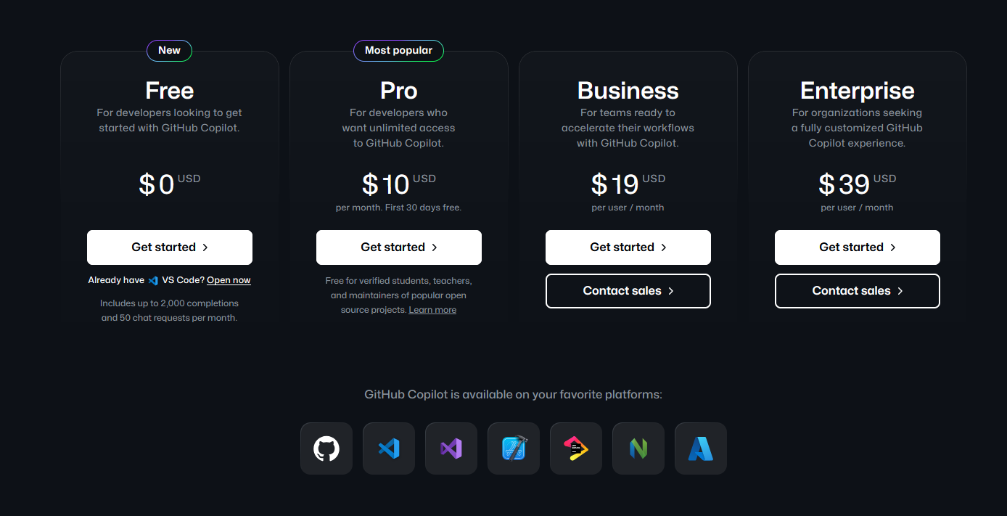
Github Copilot Plans

Slide 7

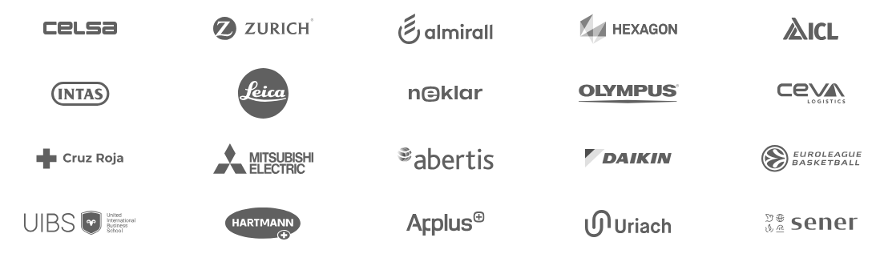
Small company of around 50 people
Focused on Software Development & IT Consulting
Based in Barcelona but with offices in Madrid and Malaga, plus remote workers around Spain.
Different and diverse clients across sectors

Slide 8
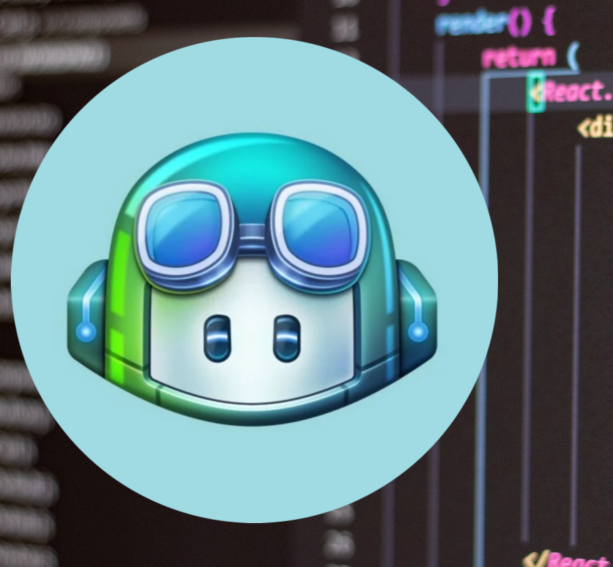
Our Situation
AI is an incredible tool that can help us a lot
Licensing costs: Is it really worth it?
Solution: Perform a trial run with a limited number of developers and calculate the benefits

Slide 9

Methodology
Developers write down tasks and estimated time of each one
Developers finish tasks by implementing the code while using Github Copilot
Developers write down the real time of each task plus comments they might have about it

Slide 10

Seems easy enough, right?
People don’t like to report every single thing they do
Estimations can be wrong
Estimations can be missing
Total monthly time reported doesn’t add up to a month

Slide 11

Simplifications
Time not reported is time not gained
Time reported but indicated as not AI-related is not considered
Cannot have a control group, tasks are assigned to one person only
We don’t modify anything depending on participants, we take the data as is.

Slide 12

Final Calculations
We calculate non-reported hours for that month for each person and consider them as hours not gained.
We add all real hours of reported tasks plus the non-reported ones and consider this the real time spent in the monthly tasks.
We divide total real hours between total monthly hours, subtract this to 1 and multiply by 100 to obtain the percentage gain.
We calculate the average of all participants
If someone didn’t report hours that month, we don’t consider them for the average calculation.

Slide 13
Monthly Results (2023)
Month | Percentage | Total Participants
March 2023 | 5% | 6
April 2023 | 10% | 4
May 2023 | 2% | 5
June 2023 | 3.5% | 6
July 2023 | 8.7% | 6
August 2023 | 9% | 6
September 2023 | 10.6% | 8
October 2023 | 1.7% | 8
November 2023 | 4.3% | 6
December 2023 | 5.7% | 4
Notes:
Average performance improvement for 2023: 6%

Slide 14

2023 Participants
Diverse clients and projects
Junior developers included
Several focused only on complex bug resolution
Reporting hard to obtain
Average improvement: 6%

Slide 15
Monthly Results (2024)
Month | Percentage | Total Participants
January 2024 | 10% | 2
February 2024 | 12.5% | 2
March 2024 | 11.24% | 4
April 2024 | 19.29% | 4
May 2024 | 17.28% | 4
June 2024 | 17.5% | 4
July 2024 | 14.3% | 4
August 2024 | 10.6% | 4
September 2024 | 15.72% | 4
October 2024 | 15.54% | 4
November 2024 | 13% | 4
December 2024 | 11.74% | 4

Slide 16

2024 Participants
Focused on same project
All Senior developers
Developing new code and tests
Reporting done regularly
Average improvement: 14,62%

Slide 17
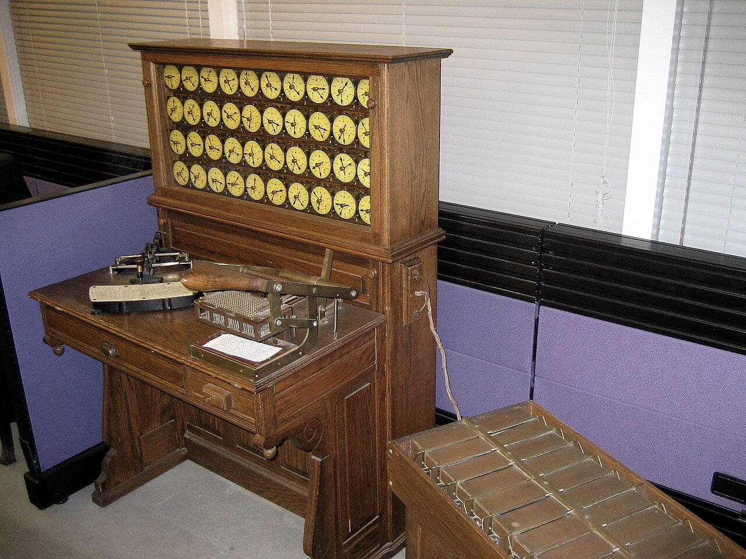


History intermission! (I)
Anyone knows about Tabulating Machines?
Anyone knows about the Computing-Tabulating-Recording Company?
Notes:
Holleritz invents tabulating machine.
IBM: International Business Machines

Slide 18


History intermission! (II)
Anyone knows which country hired tabulating machines to perform its census in the 1930s?
Anyone knows what was achieved with this census?

Slide 19

Ethics intermission!
IT advances have repercussions: Be aware of them.
Technology is cool, but only if it’s managed ethically.

Slide 20

Conclusions
No, you cannot fire a percentage of your developers.
There’s usually a good performance gain overall: A team of good AI users manages performance improvements between 10% and 20% each month, depending on the tasks.
Teams not trained, with junior members, or focused on very specialised code may not perform faster using AI.
Ideal for developing new code or unit tests.
Bugs still require people reviewing the code carefully.
Complex code still requires people reviewing the code carefully

Slide 21

Best Practices
Train developers in proper AI usage
Use AI for repetitive code
Use AI for automatic testing and unit testing
Use the different tools and plugins available with Copilot
Github Copilot doesn’t replace developers: it’s a tool to help them

Slide 22
Questions?

Slide 23
THANK YOU SPONSORS

Slide 24

Thank you
Notes:
All the demos are here!

